Slide 1
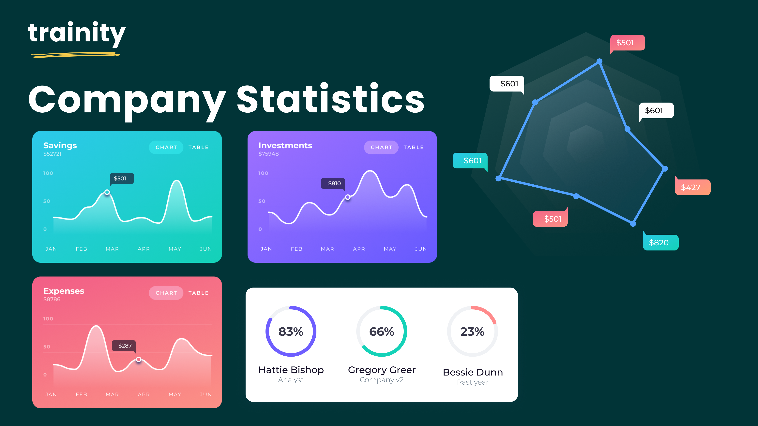
L
H
I
R
I
N
G
P
R
O
C
E
S
S
A
N
A
L
Y
S
I
S

Slide 2
PROJECT DESCRIPTION
Hiring Process Analytics is the fundamental and the most important function of a company. Here, the MNCs get to know about the major underlying trends about the hiring process.
In this project we are going to perform Exploratory Data Analysis(EDA) where we will try to summarize, visualize and identify missing values of the data which will help us to answer the various questions related to data which are asked.
Ayushi Dadhich

Slide 3
PROJECT APPROACH
Problem Statement
Data Cleaning
Microsoft Excel
Check
Duplicates
Formulas
Pivot Table
Charts
Bar Chart
Pie Chart
Worksheet
Understanding the Problem Statement and then opening worksheet.
Checked if the data is cleaned or not – for this check for missing values and duplicates.
Using Excel’s built in formulas tried to solve the questions asked.
Created pivot tables for better approach to the questions
Used the required charts for the tasks.
Ayushi Dadhich

Slide 4


TECH STACK USED
Microsoft Excel 2021
Spreadsheet tool for calculations and visual representation of data
PowerPoint 2021
Powerful slideshow presentation program

Slide 5
INSIGHTS
Gained knowledge on how to use COUNTIF, COUNTIFS function for solving how many males and females were hired.
Used AVERAGE function to calculate average offered salary.
And pivot tables for class interval of salary in the company which showed how many candidates were given a salary within a particular range.
Again, for the next task which was to show the proportion of people working in different departments. So, I created a pivot table from the provided data to show it through a pie chart.
Lastly, used bar chart and line chart to represent different post tiers.
Ayushi Dadhich

Slide 6
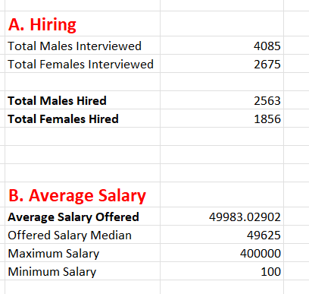
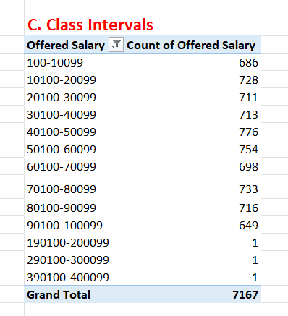
RESULTS
Ayushi Dadhich

Slide 7
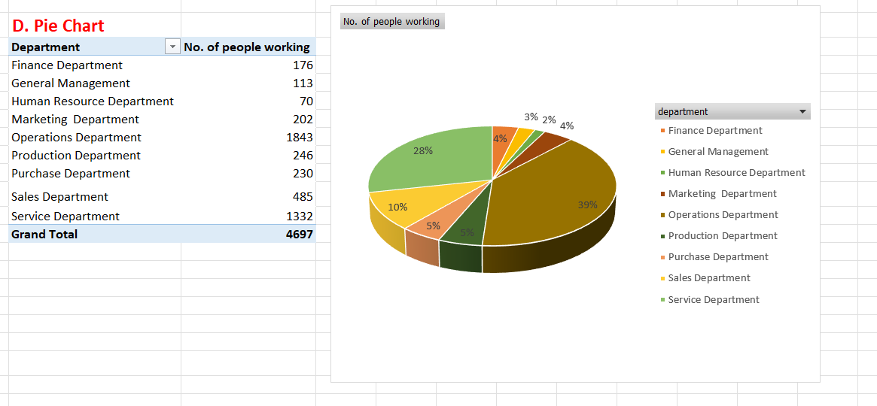
Ayushi Dadhich

Slide 8
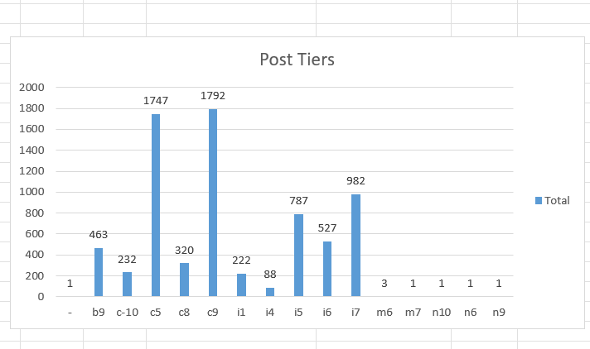
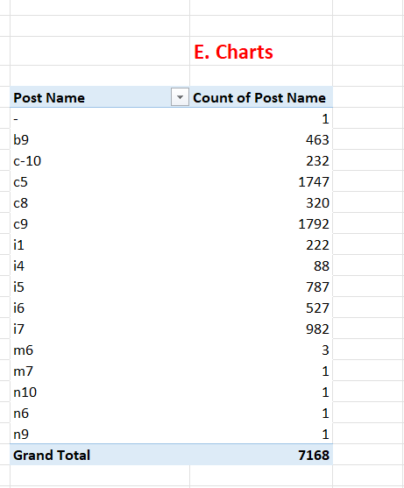
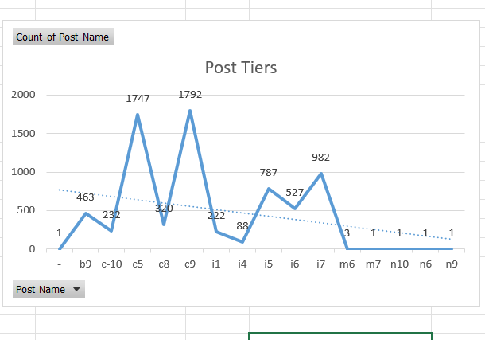
Ayushi Dadhich

